Slide 1
A core Course on Modeling
Introduction to Modeling
0LAB0 0LBB0 0LCB0 0LDB0
c.w.a.m.v.overveld@tue.nl
v.a.j.borghuis@tue.nl
S.21

Slide 2
Formalization phase: formalize relations (cont.’d)
define
formulate
purpose
conceptualize
identify
entities
choose
relations
formalize
obtain
values
formalize
relations
execute
operate
model
obtain
result
conclude
present
result
interpret
result
Notes:
2

Slide 3
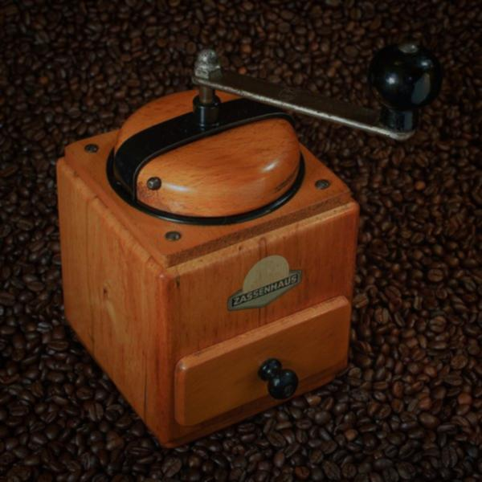
Functional Model : a model with ‘inputs’ → ‘outputs’
Examples:
purpose predict (1 ‘when …’) : input = EMPTY; output = time point
purpose predict (2 ‘what if …’) : input = if-condition; output = what will
happen
purpose decide : input = decision; output = consequence
purpose optimize : input = independent quantity;
output = target (objective, …)
http://commons.wikimedia.org/wiki/File:Coffee_Grinder_Zassenhaus.jpg
Notes:
3

Slide 4
Functional Model : a model with ‘inputs’ → ‘outputs’
Examples:
purpose steer/control : input = perturbations;
output = difference between realized
and desired value
purpose verify : input = EMPTY;
output = succeed or fail (true or false)
http://commons.wikimedia.org/wiki/File:Coffee_Grinder_Zassenhaus.jpg
Notes:
4

Slide 5
The biker’s dilemma
QUIZ
According to the preceding scene, what constitutes a ‘good bicycle trip’?
http://cdn.morguefile.com/imageData/public/files/a/annika/preview/fldr_2008_11_07/file0001549652231.jpg
Notes:
5

Slide 6
The biker’s dilemma:
riding far, get back soon, don’t get tired
http://cdn.morguefile.com/imageData/public/files/a/annika/preview/fldr_2008_11_07/file0001549652231.jpg
Notes:
6

Slide 7
The biker’s dilemma:
riding far, get back soon, don’t get tired?
s = distance (km)
t = time (hour)
W = work (Joule) = F_{w} s
= cρA v² s
…. but do we have
W=f_{W}(t,s) or
s=f_{s}(W,t) or
t=f_{t}(s,W) ?
What depends on what?
Notes:
7

Slide 8
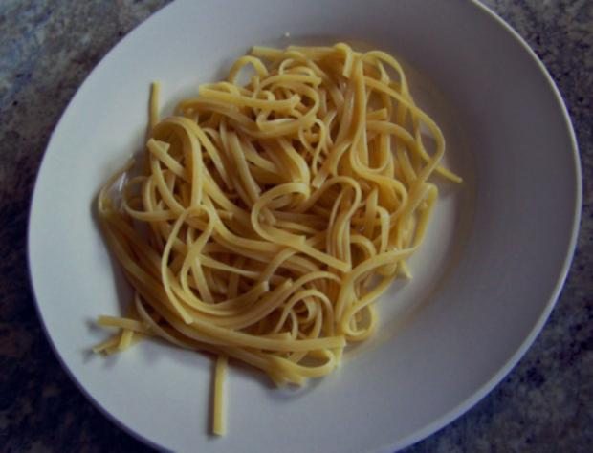
http://www.morguefile.com/archive/display/678614
Unclarity about ‘what depends on what’
is a main source of confusion in functional models.
To-do list method should prevent spaghetti.
Notes:
8

Slide 9
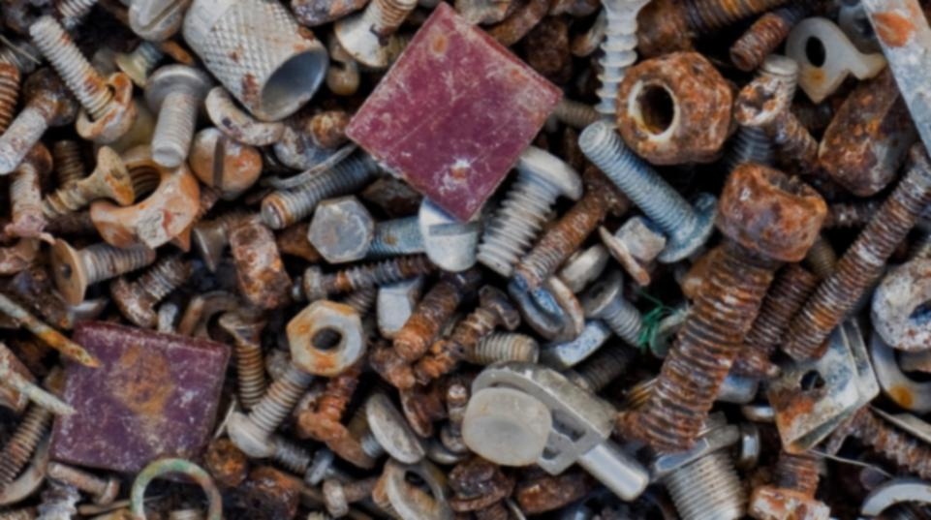
From conceptual model to formal model:
while your purpose is not satisfied:
start with quantity you need for the purpose
put this on the to-do list
while the todo list is not empty:
take a quantity from the todo list
think: what does it depend on?
if depends on nothing
substitute constant value
else
give an expression
if possible, use dimensional analysis
propose suitable mathematical expression
think about assumptions
verify dimensions
add newly introduced quantities to the todo list
todo list is empty: evaluate your model
as long as purpose is not satisfied: repeat
Elaborate each of the 3 possibilities
Notes:
9

Slide 10
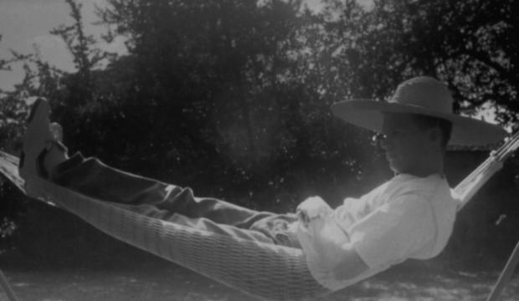
Simple cases:
trivial cases:
W minimal
t minimal
s maximal
http://cdn.morguefile.com/imageData/public/files/a/ardanea/preview/fldr_2008_11_08/file0001598281222.jpg
s = distance travelled
t = duration of the tour
W = performed work
F_{w} = wind force
c = constant
A = area
ρ = air density
Notes:
10

Slide 11
Simple cases:
trivial cases:
W minimal
t minimal
s maximal
QUIZ
For each of these cases, how should we achieve the goal?
http://cdn.morguefile.com/imageData/public/files/a/ardanea/preview/fldr_2008_11_08/file0001598281222.jpg
s = distance travelled
t = duration of the tour
W = performed work
F_{w} = wind force
c = constant
A = area
ρ = air density
Notes:
11

Slide 12
Simple cases:
trivial cases:
W minimal: s=0 ← stay at home
t minimal: s=0 ← stay at home
s maximal: t→ ∞
http://cdn.morguefile.com/imageData/public/files/a/ardanea/preview/fldr_2008_11_08/file0001598281222.jpg
s = distance travelled
t = duration of the tour
W = performed work
F_{w} = wind force
c = constant
A = area
ρ = air density
Notes:
12

Slide 13
Interesting cases:
Case 1: biking far with little effort (s should be large, W small)
Quantities needed for purpose: s, W
pick s from to do list: s depends on t and v
Expression: s = v t
pick W from to do list: W depends on F_{w} and s
Expression: W = F_{w} s
pick F_{w} from to do list: F_{w} depends on c, ρ, A and v
Expression: F_{w} = c ρ A v²
pick c from list → constant
pick ρ from list → constant
pick A from list → constant
pick t from list → choose
pick v from list → choose
s = distance travelled
t = duration of the tour
W = performed work
F_{w} = wind force
c = constant
A = area
ρ = air density
Notes:
13

Slide 14
Interesting cases:
Case 2: biking with little effort and brief (W should be small, t small)
Quantities needed for purpose: W, t
pick W from to do list: W depends on F_{w} and s
Expression: W = F_{w} s
pick F_{w} from to do list: F_{w} depends on c, ρ, A and v
Expression: F_{w} = c ρ A v²
pick c from list → constant
pick ρ from list → constant
pick A from list → constant
pick t from list: depends on s and v
Expression: t = s/v
pick s from list → choose
pick v from list → choose
s = distance travelled
t = duration of the tour
W = performed work
F_{w} = wind force
c = constant
A = area
ρ = air density
Notes:
14

Slide 15
Interesting cases:
Case 3: biking brief and far (t should be small, s large)
Quantities needed for purpose: t, s
pick t from to do list: t depends on v and s
Expression: t=s/v
pick v from list → choose
pick s from list → choose
(notice: W is irrelevant, and so are ρ, A, c and F_{w} )
s = distance travelled
t = duration of the tour
W = performed work
F_{w} = wind force
c = constant
A = area
ρ = air density
Notes:
15
If we make a round trip, we cannot choose t, because we cannot guarantee beforehand that we will be back home at the end ...

Slide 16
Interesting cases:
Case 3: biking brief and far (t should be small, s large)
Quantities needed for purpose: t, s
pick t from to do list: t depends on v and s
Expression: t=s/v
pick v from list → choose
pick s from list → choose
(notice: W is irrelevant, and so are ρ, A, c and F_{w} )
QUIZ
In this case, there is a second derivation. Which?
s = distance travelled
t = duration of the tour
W = performed work
F_{w} = wind force
c = constant
A = area
ρ = air density
Notes:
16
If we make a round trip, we cannot choose t, because we cannot guarantee beforehand that we will be back home at the end ...

Slide 17
Interesting cases:
Case 3: biking brief and far (t should be small, s large)
Quantities needed for purpose: t, s
pick t from to do list: t depends on v and s
Expression: t=s/v
pick v from list → choose
pick s from list → choose
(notice: W is irrelevant, and so are ρ, A, c and F_{w} )
alternative (if we don’t make a round trip):
pick s from to do list: s depends on v and t
Expression: s=v t
pick v from list → choose
pick t from list → choose
(notice: W is irrelevant, and so are ρ, A, c and F_{w} )
s = distance travelled
t = duration of the tour
W = performed work
F_{w} = wind force
c = constant
A = area
ρ = air density
Notes:
17
If we make a round trip, we cannot choose t, because we cannot guarantee beforehand that we will be back home at the end ...

Slide 18
Interesting cases, overview:
biking far, with
little effort
(large s, small W)
biking with little effort, and brief
(small W, small t)
biking brief and far
(small t, large s)
quantities we need
We need s and W;
s = v t
W = F_{w} s
We need W and t;
W = F_{w} s
t = s / v
We need t and s;
t = s/v
intermediate quantities
F_{w} = cρAv²
F_{w} = cρAv²
(nothing)
c, ρ, A
c, ρ, A
(nothing)
quantities from context
t, v
v, s
s, v
quantities we can choose
Notes:
18

Slide 19
s
little effort, brief
v
t
F_{w}
W
t
far, little effort
v
s
A
F_{w}
W
ρ
c
A
ρ
c
s
brief, far
v
t
s
Notes:
19

Slide 20
s
little effort, brief
v
t
F_{w}
W
t
far, little effort
v
s
A
F_{w}
W
ρ
c
A
ρ
c
QUIZ
There is something strange with the ‘brief, far’ model.
What?
s
brief, far
v
t
s
Notes:
20

Slide 21
s
little effort, brief
v
t
F_{w}
W
t
far, little effort
v
s
A
F_{w}
W
ρ
c
A
ρ
c
s
brief, far
v
t
s
Notes:
21

Slide 22
s
little effort, brief
v
t
F_{w}
W
t
far, little effort
v
s
A
F_{w}
W
ρ
c
A
ρ
c
general functional model (example)
s_{dummy}
brief, far
v
t
quantities of category I
s
quantities of category II
quantities of category IV
quantities of category III
Notes:
22

Slide 23
The general Functional Model is
a directed, a-cyclic graph
nodes: quantities
arrows: dependency relations
quantities in cat.-II: only incoming arrows
quantities in cat.-I and cat.-III only outgoing arrows
in cat.-IV all arrows allowed
green: cat.-I;
grey: cat.-II;
yellow: cat.-III;
blue: cat.-IV.
general functional model (example)
quantities of category I
quantities of category II
quantities of category IV
quantities of category III
Notes:
23

Slide 24
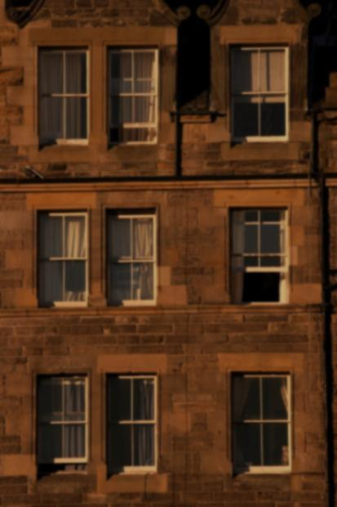
Difference between cat.-I and cat.-III quantities:
Cat.-III quantities are needed to evaluate the model, but cannot be determined by the modeler / designer;
Example: legislature, demography, physics, economy, vendor catalogues, human conditions, …
Challenge the demarcation between cat.-I and cat.–III for innovative design.
general functional model (example)
http://www.morguefile.com/archive/display/176294
quantities of category I
quantities of category II
quantities of category IV
quantities of category III
Notes:
24

Slide 25
Start the construction of the model by introducing cat.-II;
Quantities that don’t depend on anything are cat.-I or cat.-III quantities;
All other quantities are cat.-IV quantities.
general functional model (example)
quantities of category I
quantities of category II
quantities of category IV
quantities of category III
Notes:
25

Slide 26
The entire network is constructed using the scheme of chapter 4, starting with cat.-II.
When the to-do list is empty, all quantities are defined in terms of cat.-I and cat.-III quantities only.
general functional model (example)
quantities of category I
quantities of category II
quantities of category IV
quantities of category III
Notes:
26

Slide 27
 | category | depends on | meaning | type | example
I | quantity that can be freely modified | nothing | modeler’s decisions, modifications, interventions, explorations … | any | physical dimensions, options, ‘tweakable’ parameters, unknowns
II | quantity that expresses the need (purpose) of the model | I,III,IV | modeler’s goals (purpose) | often: ordinal (decide, optimize, steer/control, …) | profit, comfort, safety, …things for interest of the stakeholder
III | quantity from context (not freely modifiable) | nothing | beyond the authonomy of the modeler | any | physical constants, vendor’s catalogue data, …
IV | auxiliary, intermediate quantity | I,III,IV | internal – only needed to execute the model; values are eventually irrelevant | any
Notes:
27

Slide 28
 | category | depends on | meaning | type | example
I | quantity that can be freely modified | nothing | modeler’s decisions, modifications, interventions, explorations … | any | physical dimensions, options, ‘tweakable’ parameters, unknowns
II | quantity that expresses the need (purpose) of the model | I,III,IV | modeler’s goals (purpose) | often: ordinal (decide, optimize, steer/control, …) | profit, comfort, safety, …things for interest of the stakeholder
III | quantity from context (not freely modifiable) | nothing | beyond the authonomy of the modeler | any | physical constants, vendor’s catalogue data, …
IV | auxiliary, intermediate quantity | I,III,IV | internal – only needed to execute the model; values are eventually irrelevant | any
QUIZ
What do you know of the type of cat.-II quantities in case of purposes
deciding
optimizing
steering, controlling?
Notes:
28

Slide 29
 | category | depends on | meaning | type | example
I | quantity that can be freely modified | nothing | modeler’s decisions, modifications, interventions, explorations … | any | physical dimensions, options, ‘tweakable’ parameters, unknowns
II | quantity that expresses the need (purpose) of the model | I,III,IV | modeler’s goals (purpose) | often: ordinal (decide, optimize, steer/control, …) | profit, comfort, safety, …things for interest of the stakeholder
III | quantity from context (not freely modifiable) | nothing | beyond the authonomy of the modeler | any | physical constants, vendor’s catalogue data, …
IV | auxiliary, intermediate quantity | I,III,IV | internal – only needed to execute the model; values are eventually irrelevant | any
Notes:
29

Slide 30
 | category | depends on | meaning | type | example
I | quantity that can be freely modified | nothing | modeler’s decisions, modifications, interventions, explorations … | any | physical dimensions, options, ‘tweakable’ parameters, unknowns
II | quantity that expresses the need (purpose) of the model | I,III,IV | modeler’s goals (purpose) | often: ordinal (decide, optimize, steer/control, …) | profit, comfort, safety, …things for interest of the stakeholder
III | quantity from context (not freely modifiable) | nothing | beyond the authonomy of the modeler | any | physical constants, vendor’s catalogue data, …
IV | auxiliary, intermediate quantity | I,III,IV | internal – only needed to execute the model; values are eventually irrelevant | any
Notes:
30

Slide 31
 | category | depends on | meaning | type | example
I | quantity that can be freely modified | nothing | modeler’s decisions, modifications, interventions, explorations … | any | physical dimensions, options, ‘tweakable’ parameters, unknowns
II | quantity that expresses the need (purpose) of the model | I,III,IV | modeler’s goals (purpose) | often: ordinal (decide, optimize, steer/control, …) | profit, comfort, safety, …things for interest of the stakeholder
III | quantity from context (not freely modifiable) | nothing | beyond the authonomy of the modeler | any | physical constants, vendor’s catalogue data, …
IV | auxiliary, intermediate quantity | I,III,IV | internal – only needed to execute the model; values are eventually irrelevant | any
Notes:
31

Slide 32
purpose | cat.-I | cat.-II
predict (‘when …”) | NOTHING | time point asked for
predict (‘what if …’) | condition after ‘if’ | what is going to happen
decide (e.g., design) | decision quantities | stakeholders value (profit, safety, …)
steer / control | external perturbation | difference between desired and actual
verify | NOTHING | result of verification: true or false
optimize | independent quantity | objective quantity
Notes:
32

Slide 33
purpose | cat.-I | cat.-II
predict (‘when …”) | NOTHING | time point asked for
predict (‘what if …’) | condition after ‘if’ | what is going to happen
decide (e.g., design) | decision quantities | stakeholders value (profit, safety, …)
steer / control | external perturbation | difference between desired and actual
verify | NOTHING | result of verification: true or false
optimize | independent quantity | objective quantity
Notes:
33

Slide 34
purpose | cat.-I | cat.-II
predict (‘when …”) | NOTHING | time point asked for
predict (‘what if …’) | condition after ‘if’ | what is going to happen
decide (e.g., design) | decision quantities | stakeholders value (profit, safety, …)
steer / control | external perturbation | difference between desired and actual
verify | NOTHING | result of verification: true or false
optimize | independent quantity | objective quantity
Notes:
34

Slide 35
purpose | cat.-I | cat.-II
predict (‘when …”) | NOTHING | time point asked for
predict (‘what if …’) | condition after ‘if’ | what is going to happen
decide (e.g., design) | decision quantities | stakeholders value (profit, safety, …)
steer / control | external perturbation | difference between desired and actual
verify | NOTHING | result of verification: true or false
optimize | independent quantity | objective quantity
Notes:
35

Slide 36
purpose | cat.-I | cat.-II
predict (‘when …”) | NOTHING | time point asked for
predict (‘what if …’) | condition after ‘if’ | what is going to happen
decide (e.g., design) | decision quantities | stakeholders value (profit, safety, …)
steer / control | external perturbation | difference between desired and actual
verify | NOTHING | result of verification: true or false
optimize | independent quantity | objective quantity
Notes:
36

Slide 37
purpose | cat.-I | cat.-II
predict (‘when …”) | NOTHING | time point asked for
predict (‘what if …’) | condition after ‘if’ | what is going to happen
decide (e.g., design) | decision quantities | stakeholders value (profit, safety, …)
steer / control | external perturbation | difference between desired and actual
verify | NOTHING | result of verification: true or false
optimize | independent quantity | objective quantity
Notes:
37

